Slide 1
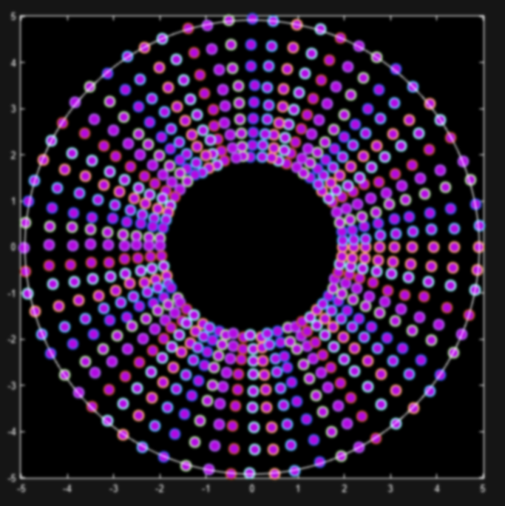
An Adaptive Calibration Algorithm Using Progressive Measurement and Accelerated Measurement Prediction
Development Update 5
Yuxuan Chen

Slide 2
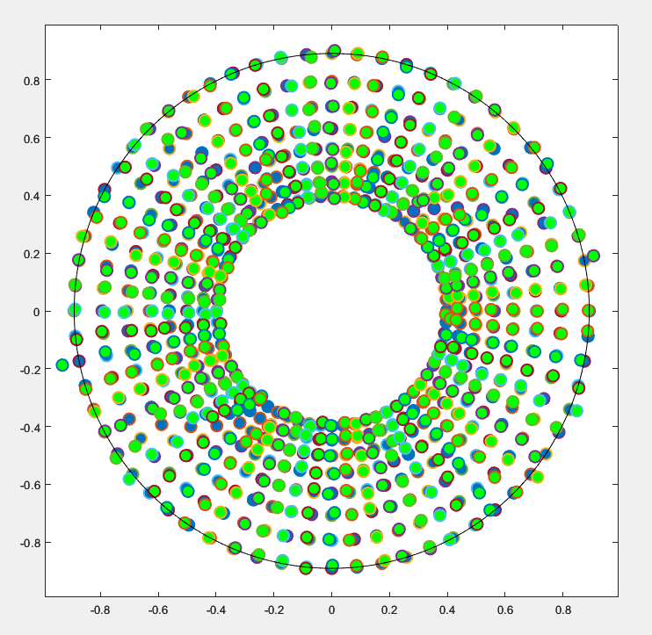
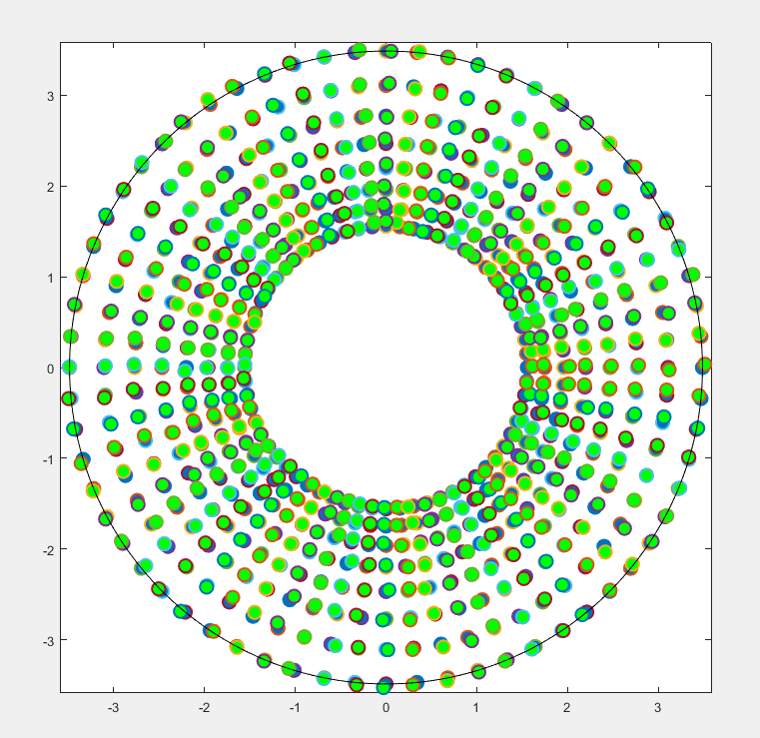
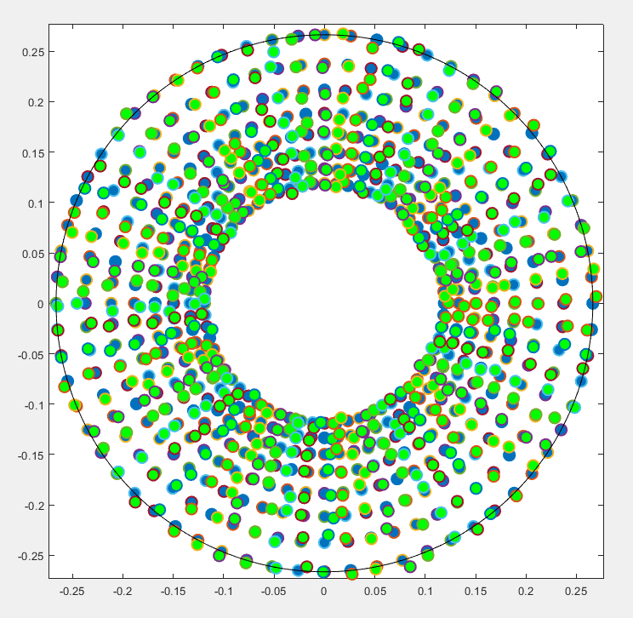
Supervised Calibration
Outphasing
Separate-Indexing
Vector-Sum
# measurements: 6947
Phase RMSE: 0.92304°
Gain RMSE: -20.5574 dB
# measurements: 1233
Phase RMSE: 0.75647°
Gain RMSE: -32.6778 dB
# measurements: 618
Phase RMSE: 1.2445°
Gain RMSE: -24.1766 dB

Slide 3
Calibration Mechanism
Point Translation
Ideal Point Position
Code/Index
Next*
Point Finding
Measurement
Measurement Point Position

Slide 4
Calibration Mechanism
Point Translation
Ideal Point Position
Code/Index
Unique for different types of variable gain phase shifters
Provides a first guess of the code/index
Established through:
Pre-characterization
DC offset, vector length, phase offset, index-to-position profile
Machine Learning

Slide 5
Calibration Mechanism
Point Finding
Next ideal Point Position
Measurement
Same for different types of variable gain phase shifters (it’s based on cartesian coordinates)
Only needed if the first guess doesn’t satisfy specified requirements
Include:
Measurement filtering and validation
Adaptive kernel search
Kernel space mapping

Slide 6
Calibration Mechanism
Point Translation
Ideal Point Position
Code/Index
Next*
Point Finding
Measurement
Measurement Point Position

Slide 7
Unsupervised Calibration
Point Translation
Ideal Point Position
Code/Index
Once Point Translation is established through pre-characterization algorithm or machine learning, the point translation algorithm computes LUT for all the ideal points.
Much fewer measurements needed for calibration.
Worse result than validated calibration.
Need accurate translation since we are not relying on kernel search.

Slide 8
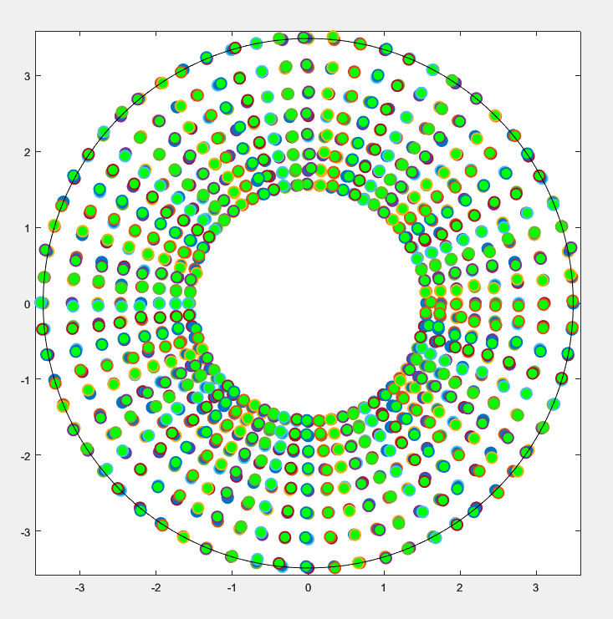
Improved Separate-Indexing Pre-Characterization
Separate-Indexing
with gain profile
Separate-Indexing with gain and phase profile
# measurements: 1233
Phase RMSE: 0.75647°
Gain RMSE: -32.6778 dB
# measurements: 1134
Phase RMSE: 0.59674°
Gain RMSE: -32.3763 dB

Slide 9
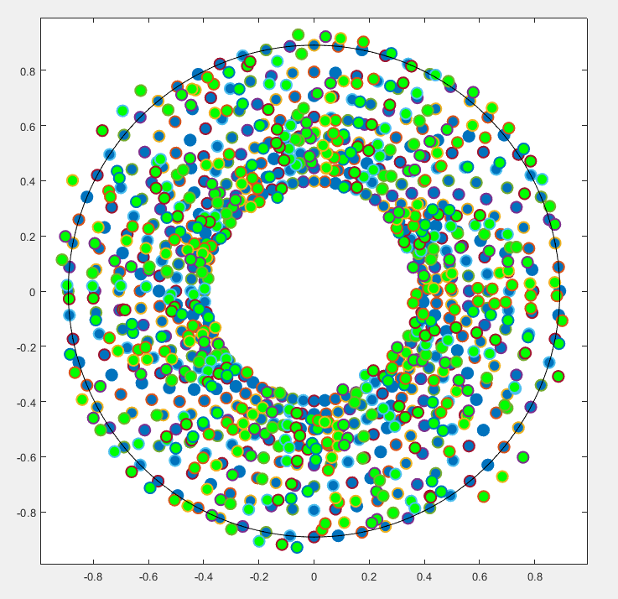
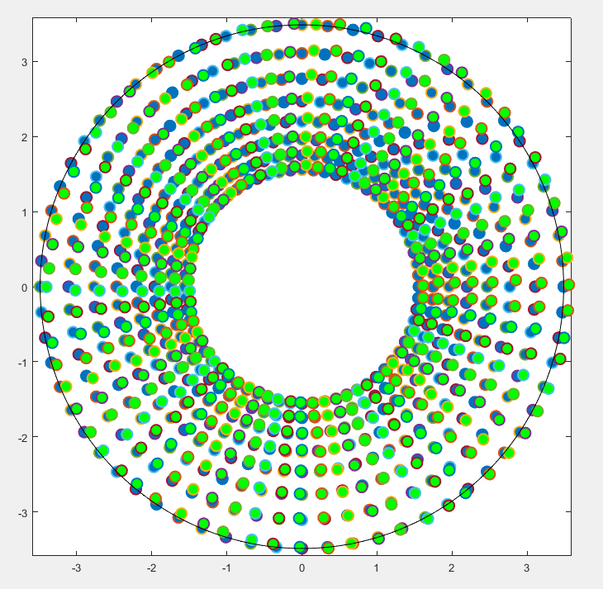
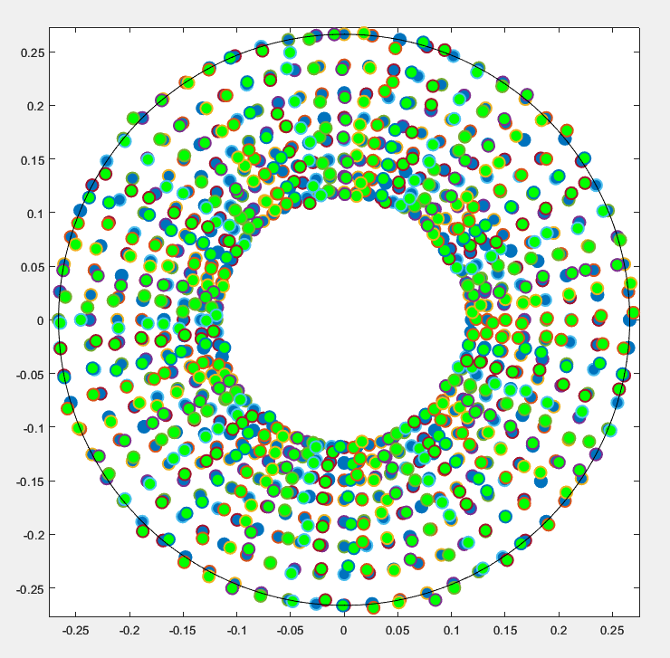
Unsupervised Calibration
Outphasing
Separate-Indexing
Vector-Sum
# measurements: 168
Phase RMSE: 3.1282°
Gain RMSE: -14.5345 dB
Hit rate: 7.0312%
# measurements: 265
Phase RMSE: 1.9125°
Gain RMSE: -25.5734 dB
Hit rate: 33.3984%
# measurements: 111
Phase RMSE: 1.2445°
Gain RMSE: -24.1766 dB
Hit rate: 100%

Slide 10
Supervised Calibration
Outphasing
Separate-Indexing
Vector-Sum
# measurements: 6947
Phase RMSE: 0.92304°
Gain RMSE: -20.5574 dB
# measurements: 1233
Phase RMSE: 0.75647°
Gain RMSE: -32.6778 dB
# measurements: 618
Phase RMSE: 1.2445°
Gain RMSE: -24.1766 dB

Slide 11
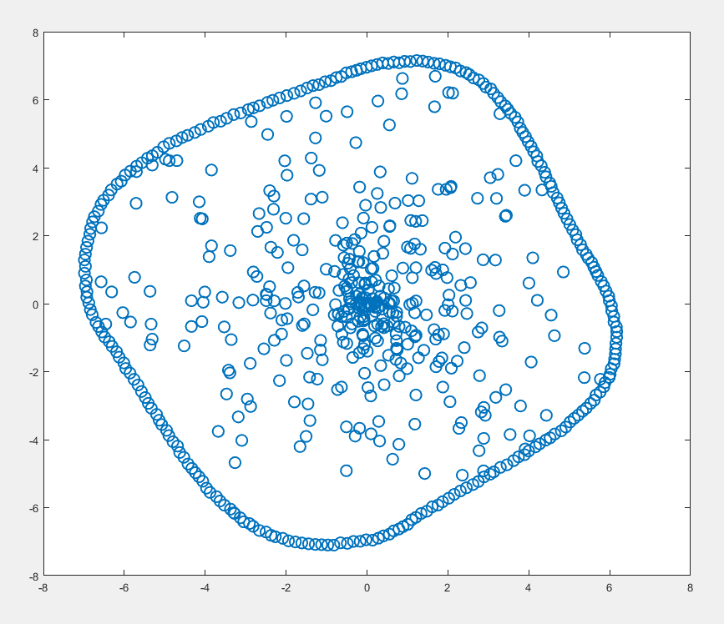
Unsupervised Calibration using Machine Learning
Instead of fitting data to pre-defined functions, we can use machine learning to learn any arbitrary constellation behaviours.
Using randomly sampled measurements, a model can be trained and be used as the pre-characterization algorithm.
Since the dataset is limited, we need to transform training data into periodic space to improve the result.
Input and output of the model are the normalized real and imaginary parts of the points.

Slide 12
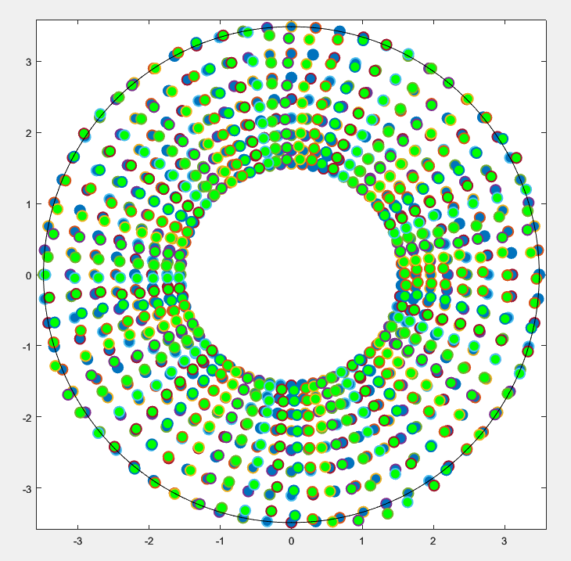
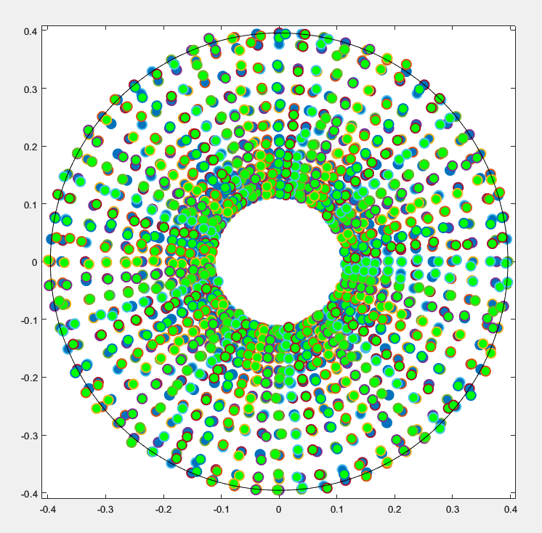
Unsupervised Calibration using Machine Learning
Separate-Indexing
Vector-Sum
# measurements: 753
Phase RMSE: 1.0627°
Gain RMSE: -27.2701 dB
# measurements: 540
Phase RMSE: 1.0733°
Gain RMSE: -46.0226 dB

Slide 13
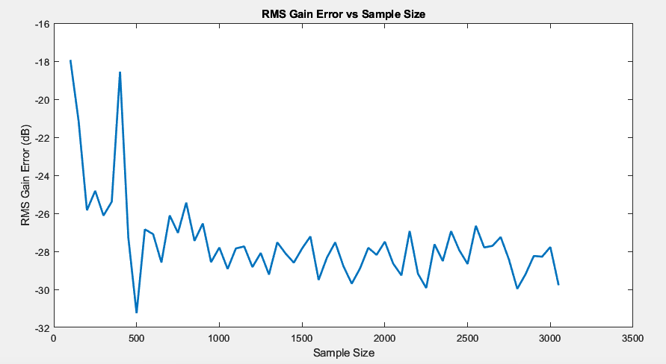
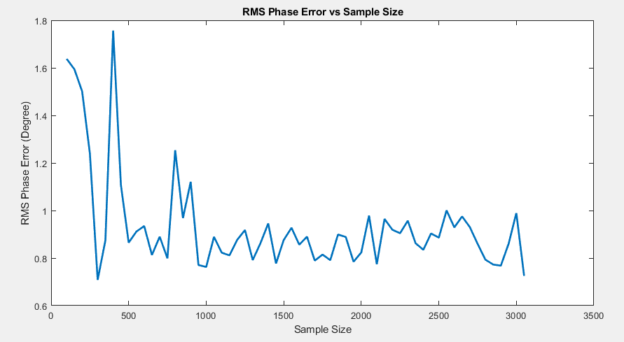
Unsupervised Calibration using Machine Learning
Separate-Indexing
gain rmse vs sample size
Separate-Indexing
phase rmse vs sample size

Slide 14
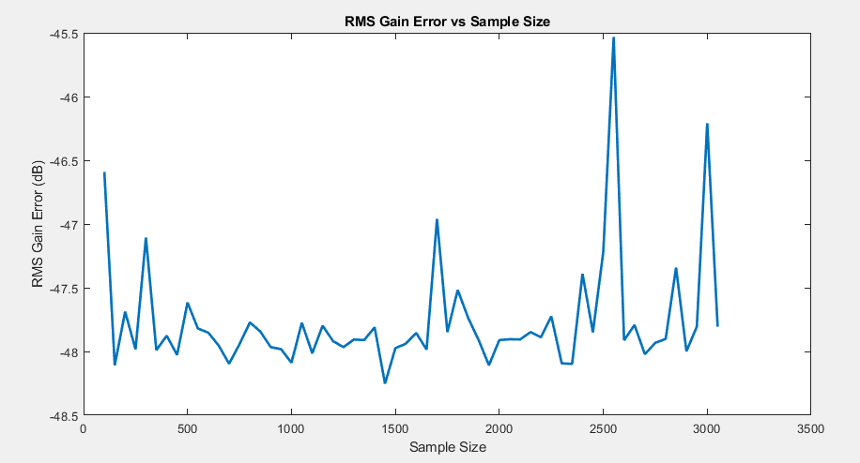
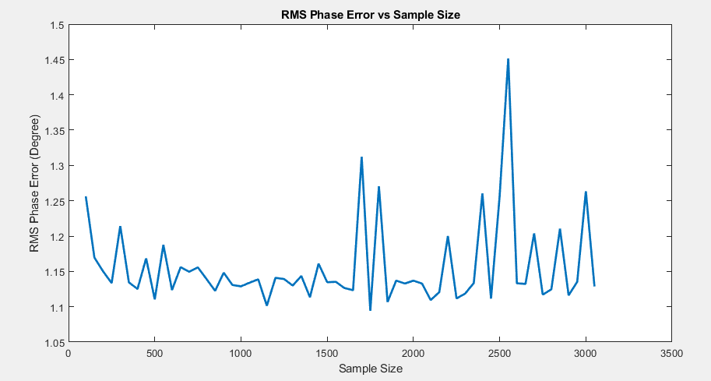
Unsupervised Calibration using Machine Learning
Vector-Sum
gain rmse vs sample size
Vector-Sum
phase rmse vs sample size

